Slide 1
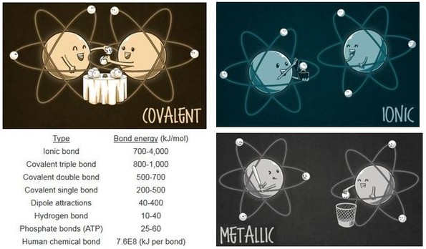
Chemical Bonds

Slide 2
Bonding and Naming
1. What is a chemical bond?
2. How do atoms bond with each other?
3. How does the type of bonding affect properties of compounds?
How can all matter in the universe exist from only 92 elements?
Why can you dissolve salt in water but not melt it easily?
Why do the carbon atoms in graphite slide off my pencil lead while diamonds are forever?
What is the role of carbon in the molecular diversity of life?
How can two toxic and violently reactive elements combine to produce table salt (essential for life)?
Why is sodium lauryl sulfate found in my shampoo)?

Slide 3
Basics
Bond
something that binds, attaches, or restrains
Chemical Bond
the force that binds atoms to each other
Why?
to Achieve Stability
(Noble Gas Configuration – s²p⁶)

Slide 4
Octet Rule
Valence electrons
Electrons in the outermost energy level of an atom
Rules
Octet—Atoms bond to achieve 8 e⁻ in outer energy level
Duet—H bonds to achieve 2 e⁻ in outer energy level

Slide 5
Electron Dot Diagrams
Group 1
Group 2
Group 13
Group 14
Group 15
Group 16
Group 17
Group 18
Xe

Slide 6
Application of Octet Rule to Ionic Compounds
Note: The element’s symbol represents the core electrons.
Dots represent the valence electrons
Na •
1s²2s²2p⁶ 3s¹

Slide 7
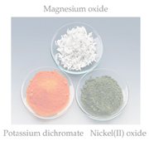
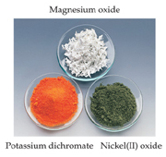
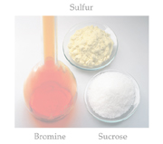
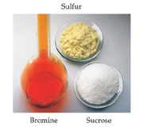
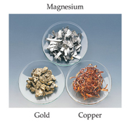
Types of Chemical Bonds
Three basic types of bonds
Ionic
Electrostatic attraction between ions
Covalent and covalent network
Shared electrons
Metallic
Metal atoms bonded to several other metal atoms

Slide 8
Types of Chemical Bonds
Type of bond → properties of compound
We will begin with ionic bonding

Slide 9
Ionic Compounds
also called salts
held together by attraction between (+) and (-) charges in a lattice
(electrostatic attraction)
these charged particles are formed by donating (and receiving) electrons
have neutral charge overall: the number of + charges = number of – charges
strength of the bond is amplified through the crystal structure

Slide 10
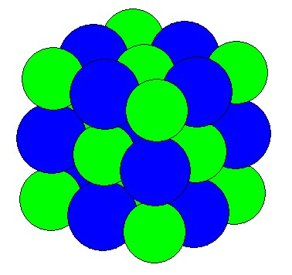
Ionic Compounds
repeating 3-D structure in crystal lattice = unit cell

Slide 11
Ionic Compounds
Energy considerations
Forming a crystal lattice → loss of a lot of PE
↑ stability
“lattice energy” = E released when 1 mol of an ionic compound is formed from gaseous ions.

Slide 12
Making NaCl
http://www.youtube.com/watch?v=2mzDwgyk6QM

Slide 13
Making NaCl

Slide 14
Lattice Energy
Definition:
lattice energy = energy released when a crystal containing 1 mole of an ionic compound is formed from gaseous ions.
Related to charge on the ion and distance between nuclei
→ higher charge → stronger pull
→ smaller means closer together → stronger pull

Slide 15
Characteristics
solid at room temperature
hard, brittle
high melting point, boiling point
usually soluble in water
conduct electricity when melted or dissolved in water (charges can move)
do not conduct electricity when solid

Slide 16
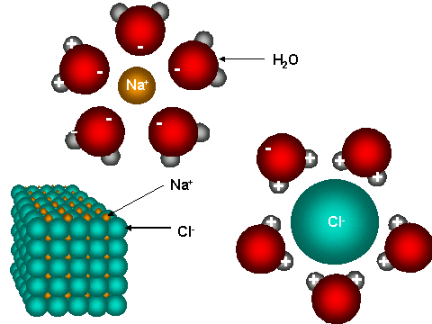
Dissolving NaCl in Water

Slide 17
Naming Chemical Compounds

Slide 18
Terms for describing how atoms bond
Chemical Formula
Relative #’s of different elements using symbols and subscripts
C₂H₄
Empirical Formula
Chemical Formula Reduced to lowest whole #’s of each element
C₂H₄→CH₂
Formula Unit
Lowest whole number ratios of Ionic Compounds
NaCl, MgBr₂, etc.

Slide 19
Terms for describing how atoms bond
Molecular Formula
Chemical formula of one molecule
e.g. C₂H₄
Structural Formula of Molecule
Shows how atoms are bonded together in a molecule
H H
C C
H H

Slide 20
Naming Ions
Monatomic
1 atom + or –
Polyatomic
Many atoms covalently bonded with an overall + or – charge (especially anions)

Slide 21
Naming Cations
1. Monatomic Cations
Use Atomic Symbol + Charge
e.g. Na⁺ = sodium Ion
(element’s name + ion)

Slide 22
Naming Cations
Polyatomic cations (Memorize these!)
NH₄⁺ ammonium ion
Hg₂²⁺ mercury(I) ion

Slide 23
How Do We Know Charges?
Apply Octet Rule (Groups 1, 2, 16, 17)
Memorize Ion List
Use Roman numberals to name elements with >1 charge
Copper(I) Ion =Cu⁺
Copper(II) Ion=Cu²⁺

Slide 24
Naming Anions
monatomic anion:
anions provide the second part of the
name of an ionic compound.
e.g. Cl⁻ chloride ion
use suffix “ide” + “ion”
Can you name the rest of the monatomic anions?

Slide 25
Naming Polyatmic Anions
Polyatomic (with oxygens)
ite NO₂⁻ Nitrite SO₃²⁻ Sulfite
ate NO₃⁻ Nitrate SO₄²⁻ Sulfate
ClO⁻=Hypochlorite=least oxygens
ClO₂⁻=Chlorite
ClO₃⁻=Chlorate
ClO₄⁻=Perchlorate=most Oxygens

Slide 26
Naming Polyatmic Anions
If the anion contains hydrogen, prefix name with “hydrogen”
HCO₃⁻ = hydrogen carbonate
HSO₄⁻ = hydrogen sulfate
HS⁻ = hydrogen sulfide
Let’s try all the phosphates that contain hydrogen:

Slide 27
Naming Binary Ionic Compounds
cation + anion
Na⁺ + Cl⁻
NaCl = sodium chloride

Slide 28
Naming Binary Ionic Compounds
Steps
Write Ions Pb⁴⁺ O²⁻
Balance Charges (LCM) 4+ 2x2-
Empirical Formula/Formula Unit PbO₂
Name Lead (IV) Oxide

Slide 29
Practice
CaCl₂
FeO
Fe₂S₃
Calcium Chloride
Iron (II) Oxide
Iron (III) Sulfide

Slide 30
Ionic Compounds Containing Polyatomic Ions
Few positive, many negative polyatomic ions
Use Atomic Symbols + Charge
polyatomic cation
NH₄⁺ ammonium ion
Hg₂²⁺ mercury(I) ion
polyatomic anion
OH⁻ hydroxide ion
CO₃²⁻ carbonate ion
Note: Charge Refers to whole groups of atoms, not just the last one

Slide 31
Polyatomic Ion Formulae
Write ions
NH₄⁺ CO₃²⁻
Balance Charges (LCM)
2 x 1+ 2-
Write Formula with lowest whole # ratios
(NH₄)₂CO₃ ammonium carbonate
Show >1 Polyatomic ion with parentheses

Slide 32
Polyatomic Ion Formulae
Practice:
aluminum sulfate
magnesium hydroxide
copper(II) acetate

Slide 33
Polyatomic Ion Formulae
Practice:
aluminum sulfate Al₂(SO₄)₃
magnesium hydroxide Mg(OH)₂
copper(II) acetate Cu(C₂H₃O₂)₂

Slide 34
Oxidation #’s
Oxidation #=Charge of an Ion
K⁺ = oxidation # of +1
O²⁻ = oxidation # of -2
We use oxidation numbers to figure out the formulas of ionic compounds.
The sum of oxidation numbers for the formulas of an ionic compounds must = 0.

Slide 35
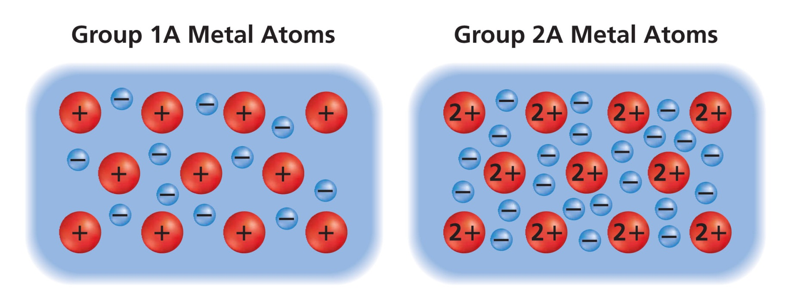
Metallic Bonds
held together by the attraction of free-floating valence electrons (-) for the positive ions in a lattice structure: “electron-sea”

Slide 36
Characteristics of Metals
Characteristics of Metals
high m.p. and b.p.
Good conductors of electricity and heat conductors in the solid state
malleable, ductile
shiny, reflective, usually gray (or grey)

Slide 37
Characteristics of Metals
As a metal is struck by a hammer, the atoms slide through the electron sea to new positions while continuing to maintain their connections to each other.

Slide 38
Alloys
Mixture of elements that has metallic properties (solid solutions)
Substitutional alloys—atoms of similar sizes
Brass (Cu +Zn)
Bronze (Cu + Sn + Pb)
Pewter (Sn + Sb + Pb)
Interstitial—much smaller atoms fill spaces between larger atoms
Carbon Steel

Slide 39
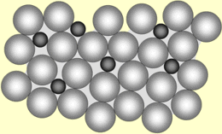
Alloys
It is more difficult for layers of atoms to move over each other, especially in interstitial alloys.
http://www.frankswebspace.org.uk/ScienceAndMaths/chemistry/alloys.htm

Slide 40
Review
Ionic compounds – crystal lattice of oppositely-charged ions, held together by electrostatic charges
Metals – lattice of positively-charged ions in a sea of electrons

Slide 41
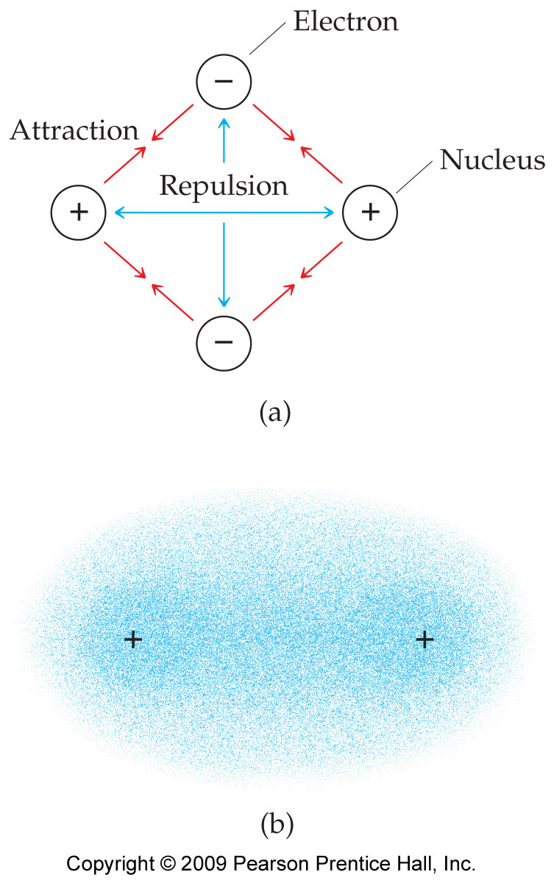
Covalent Bonding
Held together by shared electrons (covalent bond)
Both electrons spend time around each nucleus but spend most of their time in the middle

Slide 42
Diatomic Elements
Memorize: N O F Cl Br I H
all exist diatomically in nature (more stable): N₂ O₂ F₂ Cl₂ Br₂ I₂ H₂
7- rule: Go to Element #7, travel across to Group 7A, then down in the shape of a 7.
Another way to remember them:
Hairogens: H₂ (H), N₂ and O₂ (air), F₂, Cl₂, Br₂, I₂ (halogens)

Slide 43
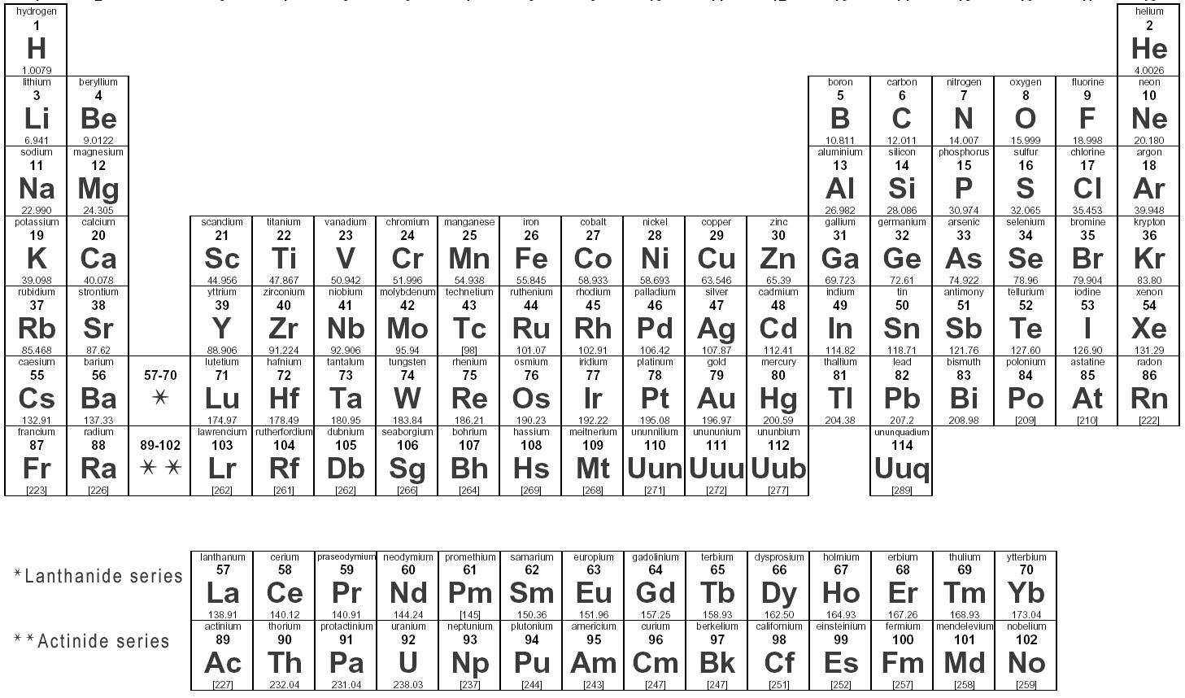
Diatomic Molecules
7 Elements bond with themselves (increased stability)
H→H₂
N→N₂
O→O₂
F→F₂
Cl→Cl₂
Br→Br₂
I→I₂

Slide 44
Covalent Bonding
Characteristics of covalently-Bonded compounds (molecules)
relatively low m.p. and b.p.
do not conduct electricity under any circumstances
generally not soluble in water, but soluble in alcohol

Slide 45
Covalent Network Solids
form covalent bonds in all directions → continuous network of strong covalent bonds → no individual molecules
extremely hard, very high m.p. and b.p.
nonvolatile, insoluble in all solvents
brittle, nonconductors of heat and electricity
diamond (C), quartz (SiO₂)

Slide 46
Compare structures of networks/lattices:
Covalent network (quartz, SiO₂)
Salt (NaCl)
Metal (Cu)

Slide 47
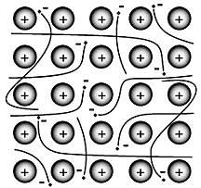
Chemical Bonds
Metallic ‘bond’
Metals and Alloys
‘Sea’ of electrons
Ionic bond
Ionic Compounds or Salts
Metal + Non-metal: NaCl, MgSO₄
Electrons exchanged between atoms
Covalent bond
Molecules and covalent network solids
Non-metals: H₂O, CH₄
Electrons shared among atoms

Slide 48
Formation of a Covalent Bond
Covalent Bond
When orbitals from two atoms overlap
2 electrons of opposite spin in the overlap
As the amount of overlap ↑, the energy of the interaction ↓
When minimum energy is reached, bonding distance occurs
Attraction and repulsion of electrons and nuclei are exactly balanced
At some distance, nuclei repel, increasing energy again

Slide 49
Formation of a Covalent Bond

Slide 50
Energy Considerations
What does “stable” mean? Changes that lower potential energy are favored.
In covalent bonds:
Shared electrons → loss of PE
→ stability
Bond energy = energy required to break a chemical bond and form neutral atoms

Slide 51
Relationship between bond length and bond energy in molecules
Bond length = average distance between two bonded atoms (distance of minimum potential energy)
As E_{bond} ↑ , Length_{bond} ↓, because the closer the atoms are, the more attraction between nuclei and electron clouds.
∴ harder to separate.

Slide 52
Naming Molecular Compounds
2 systems – prefixes, vs. oxidation numbers (Honors/AP)
See p. 248 in textbook for list of prefixes to memorize

Slide 53
Naming Molecular Compounds
A. Prefixes, roots, suffixes
Begin with element with lowest electronegativity. Nitrogen
Add appropriate prefix (unless it is mono-). Dinitrogen
End second element with "ide" (as for ionic compounds…). Oxide
4. Use appropriate prefix for second element. tetroxide
→ dinitrogen tetroxide
→ N₂O₄

Slide 54
Oxidation Numbers (p. 2 of Honors Supplement)
Oxidation number = the charge on an ion
e.g. K⁺ has an oxidation number of 1+
O²⁻ has an oxidation number of 2-
We use oxidation numbers to figure out the formulas of ionic compounds.
The sum of oxidation numbers for the formulas of an ionic compounds must = 0.

Slide 55
Oxidation Numbers
We can also use oxidation numbers for molecular compounds, by pretending the atoms are ions = “apparent charge”.

Slide 56
Oxidation Numbers
The oxidation number of:
an element in the uncombined state is 0.
a monatomic ion equals the charge on the ion.
hydrogen is generally +1; in hydrides, -1.
oxygen is generally -2; in peroxides, -1.

Slide 57
Oxidation Numbers
The oxidation number of:
the more electronegative element in a binary covalent compound is negative, while that of the other element is positive.
elements other than oxygen and hydrogen in a neutral compound is such that the sum of the oxidation numbers for all atoms in the compound is 0.
elements other than oxygen and hydrogen in a polyatomic ion is such that the sum of the oxidation numbers for all atoms in the ion equals the charge on the ion.

Slide 58
Use these rules to assign oxidation numbers to each element in each of the given formulas
e.g. H₂O H: 2 x +1, O: -2
N₂ 0

Slide 59
Compounds That Become Acids When Dissolved in Water
General Formula: HX
H⁺ X⁻
monatomic
or
polyatomic
anion

Slide 60
Compounds That Become Acids When Dissolved in Water
Three Rules:
When X ends in “ide”
(e.g. chloride, cyanide)
→ “hydro_______ ic acid”
e.g. hydrochloric acid,
hydrocyanic acid

Slide 61
Compounds That Become Acids When Dissolved in Water
Three Rules:
When X ends in “ite”
(e.g. chlorite, sulfite)
→ “______ous acid”
e.g. chlorous acid
sulfurous acid

Slide 62
Compounds That Become Acids When Dissolved in Water
Three Rules:
When X ends in “ate”
(e.g. chlorate, sulfate)
→ “______ ic acid”
e.g. chloric acid
sulfuric acid

Slide 63
Compounds That Become Acids When Dissolved in Water
Your turn:
HBr
HNO₂
HNO₃

Slide 64
Compounds That Become Acids When Dissolved in Water
Your turn:
HBr hydrobromic acid
HNO₂ nitrous acid
HNO₃ nitric acid

Slide 65
Molecules and Lewis Structures
Lewis structures show
All atoms in the molecule
How atoms are connected (# of bonds)
Any unshared electron pairs (lone pairs)

Slide 66
Making Lewis Structures
Find total # of valence e⁻’s for ALL atoms (for ions, consider the charge).
2. Write atom symbols, beginning with the central atom:
Carbon in center – CH₄
Most electropositive in center – SO₄²⁻
Non metal (other than H or O) in center – H₂PO₄⁻
Hydrogen and oxygen are usually on the outside

Slide 67
Making Lewis Structures
Add valence e’-s to each atom, beginning with the bonding electron for each atom added to the central atom.
Shared e⁻ pairs represent bonds and are counted in the valences of both elements.
5. Adjust so that each element has 8 valence electrons (2 for H), note exceptions…

Slide 68
Ionic, polar covalent or nonpolar covalent?
The nature of the bond between any two atoms is determined by the difference in their electronegativities (see chart on ho)
The greater the difference, the more ionic the bond (on a continuum)
ionic
covalent
4.0
1.7
0.4
0
polar (P)
NP

Slide 69
Ionic range: 4.0 - 1.8
Cl – Na: 3.0 - 0.9 = 2.1 (ionic)
Polar covalent range: 1.7 - 0.5
Cl – Al: 3.0 - 1.5 = 1.5 (polar covalent)
Nonpolar covalent range: 0.4 - 0.0
Cl – Br: 3.0 - 2.8 = 0.2 (nonpolar covalent)
ionic
covalent
4.0
1.7
0.4
0
polar (P)
NP
Cl - Na
Cl - Al
Cl - Br

Slide 70
Ionic, polar covalent or nonpolar covalent?
ionic bonds - the less electronegative atom donates 1 or more e⁻’s to the more electronegative atom
covalent bonds - e⁻’s from both atoms are shared
Polar covalent bonds - e⁻’s are shared, but are not shared equally between two atoms
nonpolar covalent bonds- e⁻’s are shared equally between two atoms

Slide 71
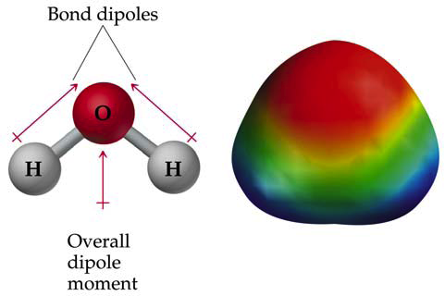
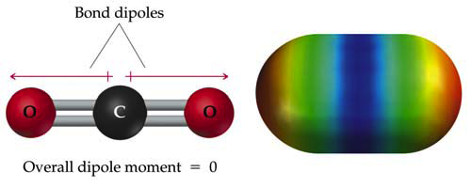
Polar vs. Non-polar: a matter of symmetry

Slide 72
Determining Molecule Polarity
Draw electron dot diagram (Lewis structure) of the molecule, let lines represent bonds
Compare the electronegativities of each of the bonded atom pairs
Determine whether each bond is polar (P) or nonpolar (NP)
Draw an arrow parallel to each bond directed towards the more electronegative atom
Is the molecule symmetrical? (If you cut it through the xy, xz and yz planes, would it split into mirror images that are identical?)
Yes - molecule is NP
No - molecule is P

Slide 73
Comparing Bond Types
Properties | Ionic: salts | Metallic | Covalent: molecules | Covalent network
Description of bond
General appearance
Malleable vs. brittle
Conduct electricity?
Under what circumstances?
m.p., b.p.
State of matter at room temp?

Slide 74
Comparing ALL bond types:
Which is stronger?
covalent network > metallic > ionic > covalent (molecules) > H bond > dipole > dispersion
e.g. Compare melting points:
SiO₂ > Fe > NaCl > C₁₂H₂₂O₁₁ > H₂O > HCl > H₂
sand > iron > salt > sugar > ice > hydrogen chloride > hydrogen gas

